Slide 1
QCJSON and JSON
CIT 360 GROUP 4 EDGAR ROMERO

Slide 2
CODING TOPIC INTRODUCTION
JSON Serialization
JavaScript Object Notation (JSON: pronounced like the name Jason in English) came into being around 2001.
Its purpose is to allow for a language independent way of transmitting and storing data. It became one of the many such text based data transfer specifications such as XML. JSON was originally was used with JavaScript however implementations of JSON libraries exist in many different languages.
References
Doing more with Java, page 46
QCJSON and JSON:
https://www.geeksforgeeks.org/parse-json-java/
https://jsonformatter.curiousconcept.com/
https://www.github.com/yenrab/qcJSON
http://jsonlint.com/

Slide 3
QCJSON and JSON
JavaScript Object Notation (JSON) is a text format for the serialization of structured data. It comes from object literals in JavaScript.
JSON can represent four primitive types (strings, numbers, booleans, and null) and two structured types (objects and arrays).
A string is a sequence of zero or more Unicode characters.
An object is an unordered collection of zero or more name/value pairs, where a name is a string and a value is a string, number, boolean, null, object, or array. An array is an ordered sequence of zero or more values.
JSON's design goals were for it to be minimal, portable, textual, and a subset of JavaScript.

Slide 4
QCJSON and JSON
About JSON
● Data-centric
● Requires name:value pairs
● Serializes data
● Smaller file size, fast
● Made of Arrays and Objects
● Subset of JavaScript
● Plays well with jQuery
Working with JSON
Like XML, JSON can be a text file as in staticdata.json JSON usually comes from a server.

Slide 5
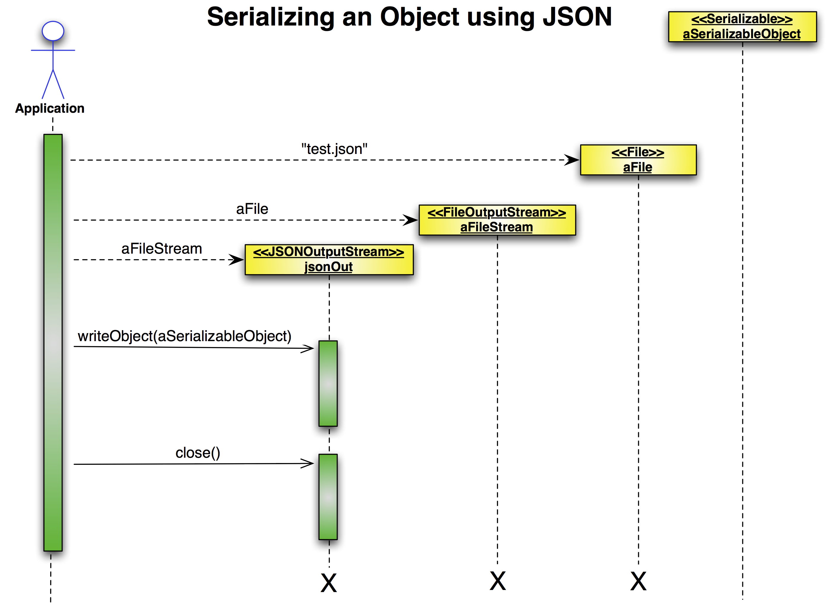
QCJSON and JSON
Diagram 1: the application controller pattern as a class diagram

Slide 6
Parsing and Getting JSON Strings
There are many JSON libraries and several of these are written in Java. Some are more complicated than others yet all yield essentially the same results. The library used in these examples will be the QCJSON library available at https://www.github.com/yenrab/qcJSON.
Code Snippet 1 shows a simple Java class, TestObject. Code Sample 2 shows an Instance of TestObject being created and then written to the console.

Slide 7
Parsing and Getting JSON Strings
public class TestThing implements Serializable {
private String theString;
private int theInt;
private Date theDate;
public TestObject(String aString, int anInt, Date aDate){
theString = aString;
theInt = anInt;
theDate = aDate;
}
}
TestObject anInstance = new TestThing("Hello there.", 7,
new Date(1067899));
try {
String jsonString = JSONUtilities.stringify(anInstance);
System.out.println(jsonString);
}
catch (JSONException e) {
e.printStackTrace();
}
The result printed out in the console is a JSON string.
{"theString":"Hello there.","theInt":"7", "theDate":"Wed Dec 31 17:17:47 MST 1969"}
Converting a JSON string into a Java instance is done in much the same way.

Slide 8
Creating JSON FILE
Create a file and call it contacts.json
Type Name="Your Name Here"
Replace this with an array Contacts=["your name"," friend1","friend2"]
Turn the Array into an Object by replacing the [ ] with { } and adding name:value pairs Contacts = {"Name": "your name","Address": "123 Main Street","Phone Numbers": ["714-432-1234","714-8310-9754","714-765-4534"]}
Contacts can now be used. Copy the code between the { } and paste it into http://jsonlint.com and click validate
If it is correct then it will say Valid JSON Modify the JSON until it does.
Add 2 more people to the Contacts JSON file and validate it.
contacts.json can now be used in a web application as it is.
You can also declare a JavaScript variable with it like this:
var Contacts = {"Name": "your name","Address": "123 Main Street","Phone Numbers": ["714-432- 1234", "714-8310-9754", "714-765-4534"]};
Copy the above variable, and open the Chrome web browser
Right-click on the page and select Inspect Element, then click the Console tab
Paste the JavaScript variable into the console and press enter. Then type console.log(Contacts);
Notice the Object {Name: "your name", Address: "123 Main Street", Phone Numbers: Array[3]}
Open the Object and find the phone numbers inside it.
Diagram 1: the application controller pattern as a class diagram

Slide 9
REVIEW QCJSON and JSON
JSON is widely used
The syntax is simple and easily readable
It is light-weight and great for using in AJAX- driven User Interfaces such as those created with jQuery UI
To remember:
In JSON, An object is an unordered set of name/value pairs, so JSONObject doesn’t preserve the order of an object’s name/value pairs, since it is (by definition) not significant. Hence in our output file, order is not preserved.

